Slide 1

Areni
Bridging the education gap
for resettled refugees.
أرني

Slide 2
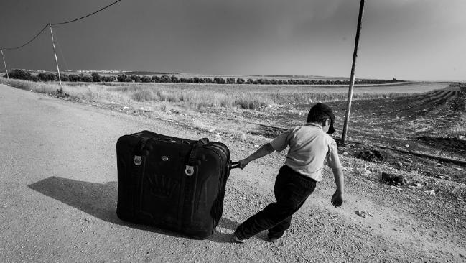

3.7M refugee children not in school
4 years spent out of school
The Problem(s)
1/100 attend university

Slide 3



The problems
Gaps in education
Cultural disconnect
Lack of local resources

Slide 4




Areni accelerates learning and integration for resettled youth refugees by facilitating in-person meetings with local tutors.
Notes:
Not just technology for the sake of technology — technology centered around people and helping newly settled refugee children and their families build real connections with community members.
Distinguishing factor: real, in-person connection.

Slide 5



Students:
Instructors:
Find a tutor by subject, location and language
Schedule free tutoring sessions
Chat within the app
View tutor ratings
Create a profile including subjects, language
Organize tutoring sessions at their own convenience
Chat within the app
Log volunteer hours
★★★★☆

Slide 6
Demonstration

Slide 7

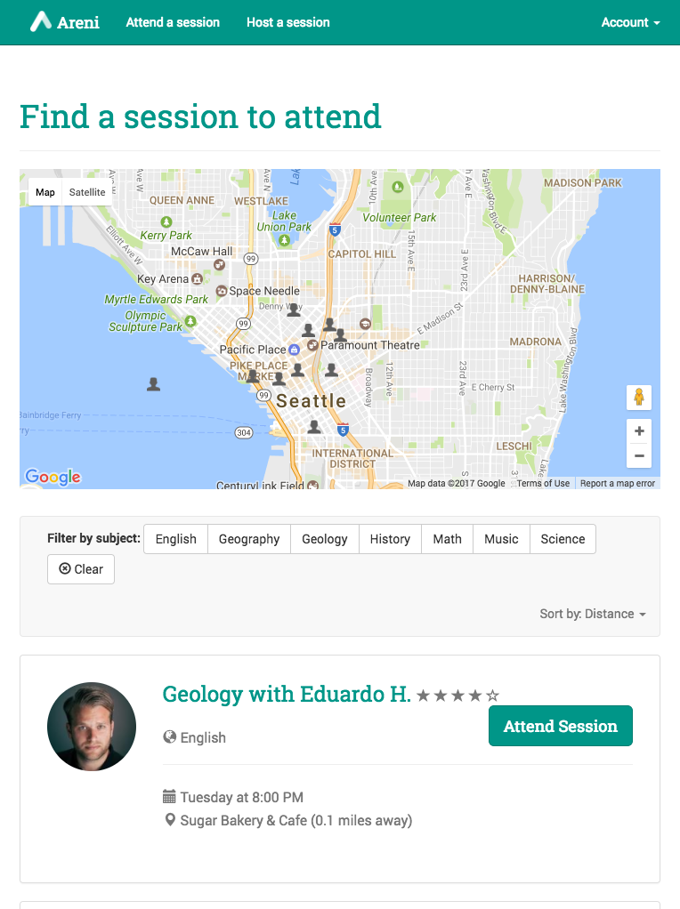
Technology stack
Google Maps API
AngularJS
FireBase
Bootstrap
Responsive

Slide 8
Sustainability
Users
Refugee children
Parents
Providers
University students
Retired teachers
Partners
Cafés, libraries
Schools, non-profits
Areni
Notes:
We already have a partner cafe scratch deli in seattle which could provide free coffe for refugee
Universities will help advertise ou plateform in the univesities

Slide 9
Roadmap
City-by-city expansion, starting with Seattle (top 10 refugee population in the United States)
Prove the model, then grow
Target communities with large refugee populations, willing volunteers
Work with local host organizations and schools
Notes:
Top-10 city

Slide 10
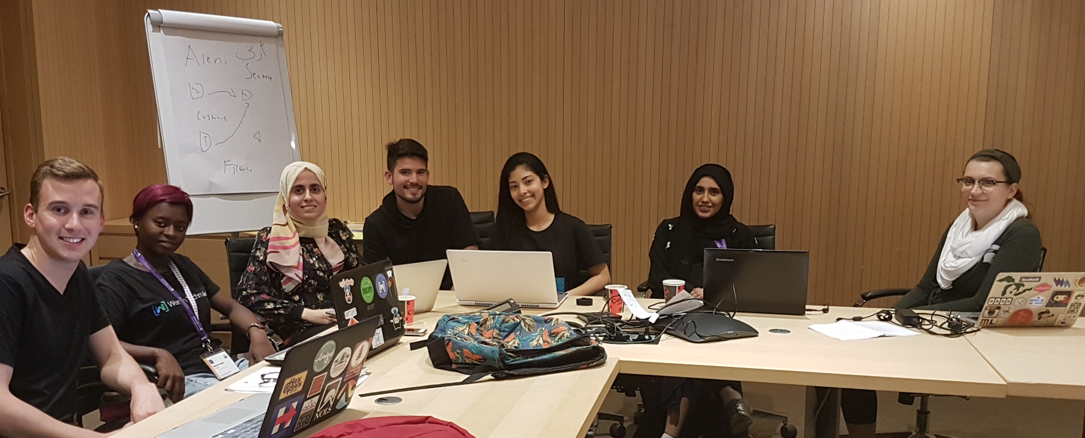
Thank you!
Areni
أرني
Students:
Mariam Garba (University Of Ilorin, Nigeria) jumokemariam@gmail.com
Zach Sorenson (Stanford University, USA) zws@stanford.edu
Shaikha Aldoukhi (Khalifa University, UAE) shaikhaaldoukhi@gmail.com
Sana Khiari (INSAT, Tunisia) Sana.khiarii@gmail.com
Mentors:
Samr Samir Ali (Teaching and Research Assistant, Abu Dhabi University, UAE) cen.ssali@gmail.com
Erin Hoffman (PhD, University of Washington, USA) erinrhof@uw.edu
Mike Clarke (Director, HiL, Lebanon) mclarke.reds@gmail.com

Slide 11
Areni
أرني

Slide 12
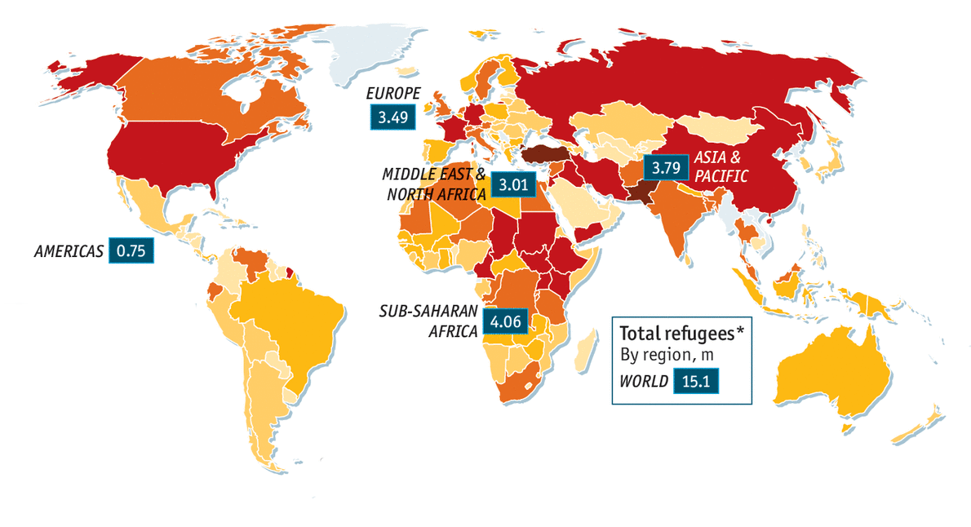
Growth plan
Short-term
Successful in Seattle (1000 sessions/month)
Identify next three cities for expansion, including finding partner agencies
Long-term
Expand to Arab and European cities, full language globalization
Mobile apps
Notes:
Top-10 city

Slide 13
Competitor landscape
Online learning platforms (e.g. World Vision program)
Areni facilitates in-person meetings, which helps with cultural integration
UN studies show that e-learning insufficient without in-person contact
Paid tutoring programs (e.g. Tutorama)
Areni is free for students, specifically targeted to refugees
Full-time volunteer programs (e.g. Jusoor in Lebanon)
Areni has a flexible time commitment, works in any location
Volunteer opportunity aggregators (e.g. JustServe)
Areni works both ways: allows tutors to find opportunities, students to find tutors
Notes:
Top-10 city

Slide 14
Volunteer sources
University students
Often required to volunteer a certain number of hours per semester
Teacher training programs
Gives student-teachers extra practice working with students
Retired teachers
Opportunity to give back to and stay involved with community
Other community members with teaching or language experience
Many people want to volunteer working with refugees but don’t have an easy way to get involved
Notes:
Top-10 city

